Slide 2
file:///C:/Users/spravca/Downloads/10_replikacia(2).pdf

Slide 3
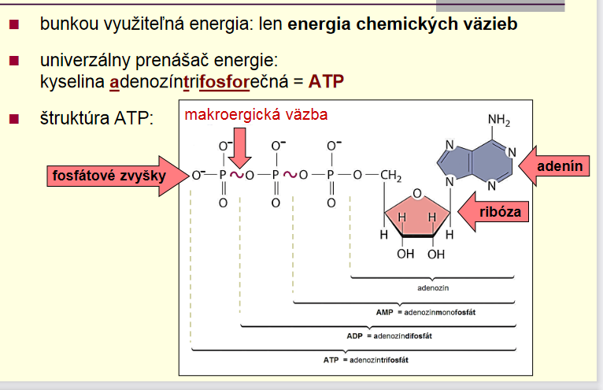
Energia makroerg. v: 50 kJ.mol⁻¹

